Slide 1
Screening of compounds for potential inhibitors using Machine Learning
-Shruti Balaji

Slide 2
OBJECTIVE
01
DATASET CURATION
02
FEATURE EXTRACTION
03
DESIGN A BINARY CLASSIFICATION MODEL
‹#›

Slide 3
Collection of inhibitors and non-inhibitors
The inhibitor and non-inhibitors for the model was collected from https://mblinhibitors.miamioh.edu/.
The list of compounds in the database was categorised as inhibitor and non-inhibitor based on the parameters (IC50 and Ki).
Compounds with IC50<10uM or Ki<2uM is categorised as inhibitor and rest of the compounds is considered as non-inhibitors.
Compounds (https://mblinhibitors.miamioh.edu/)
Inhibitors (471)
Non-inhibitors (409)
IC50<10uM or Ki<2uM
IC50>10uM or Ki>2uM

Slide 4
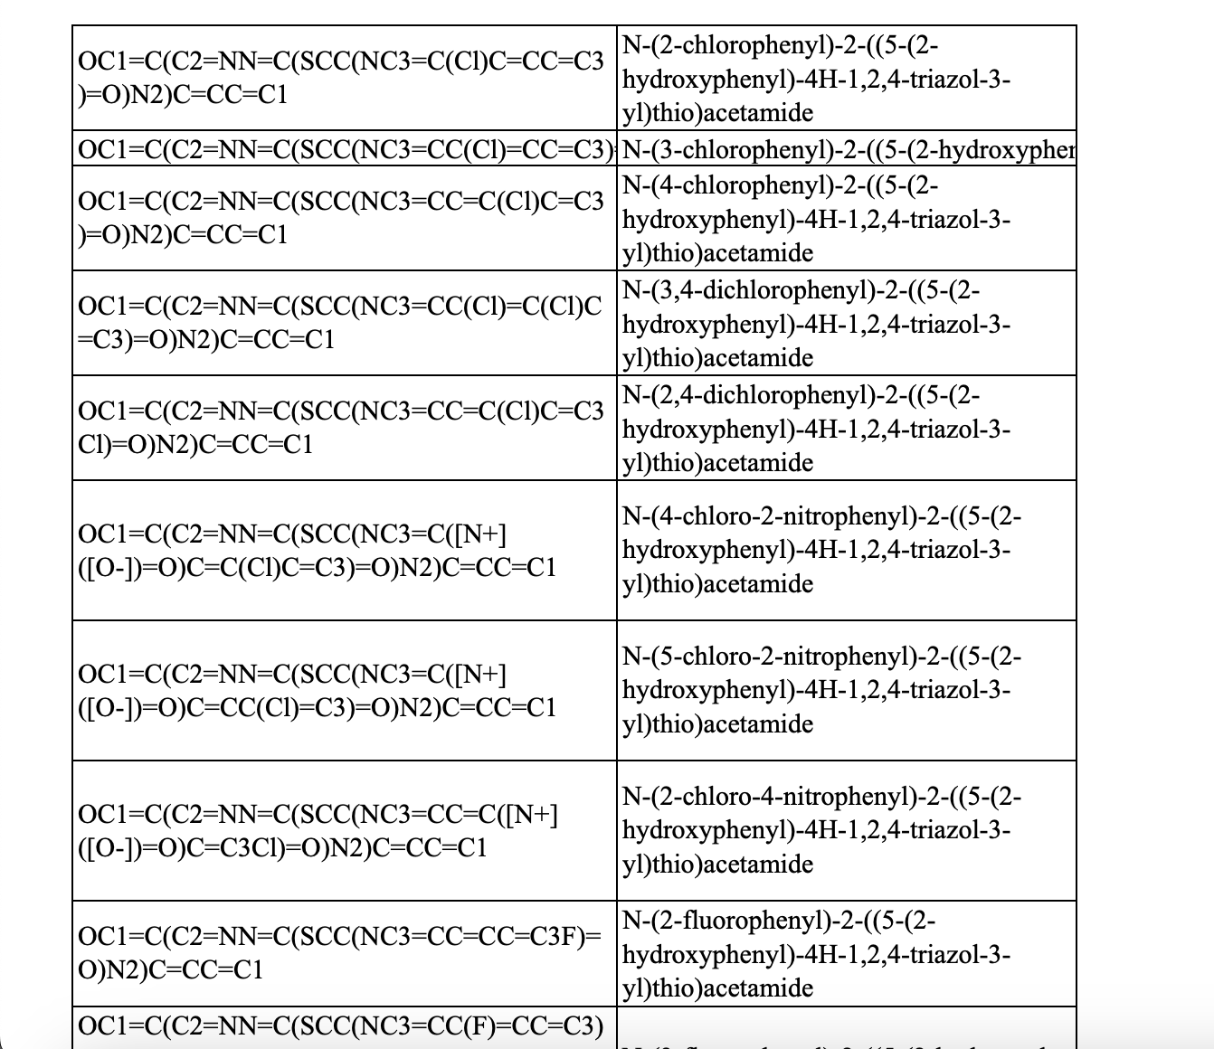
DATASET FOR BINARY CLASSIFICATION
KNOWN INHIBITORS
KNOWN NON-INHIBITORS
COMPOUND SMILES
NAME OF THE COMPOUND
‹#›

Slide 5
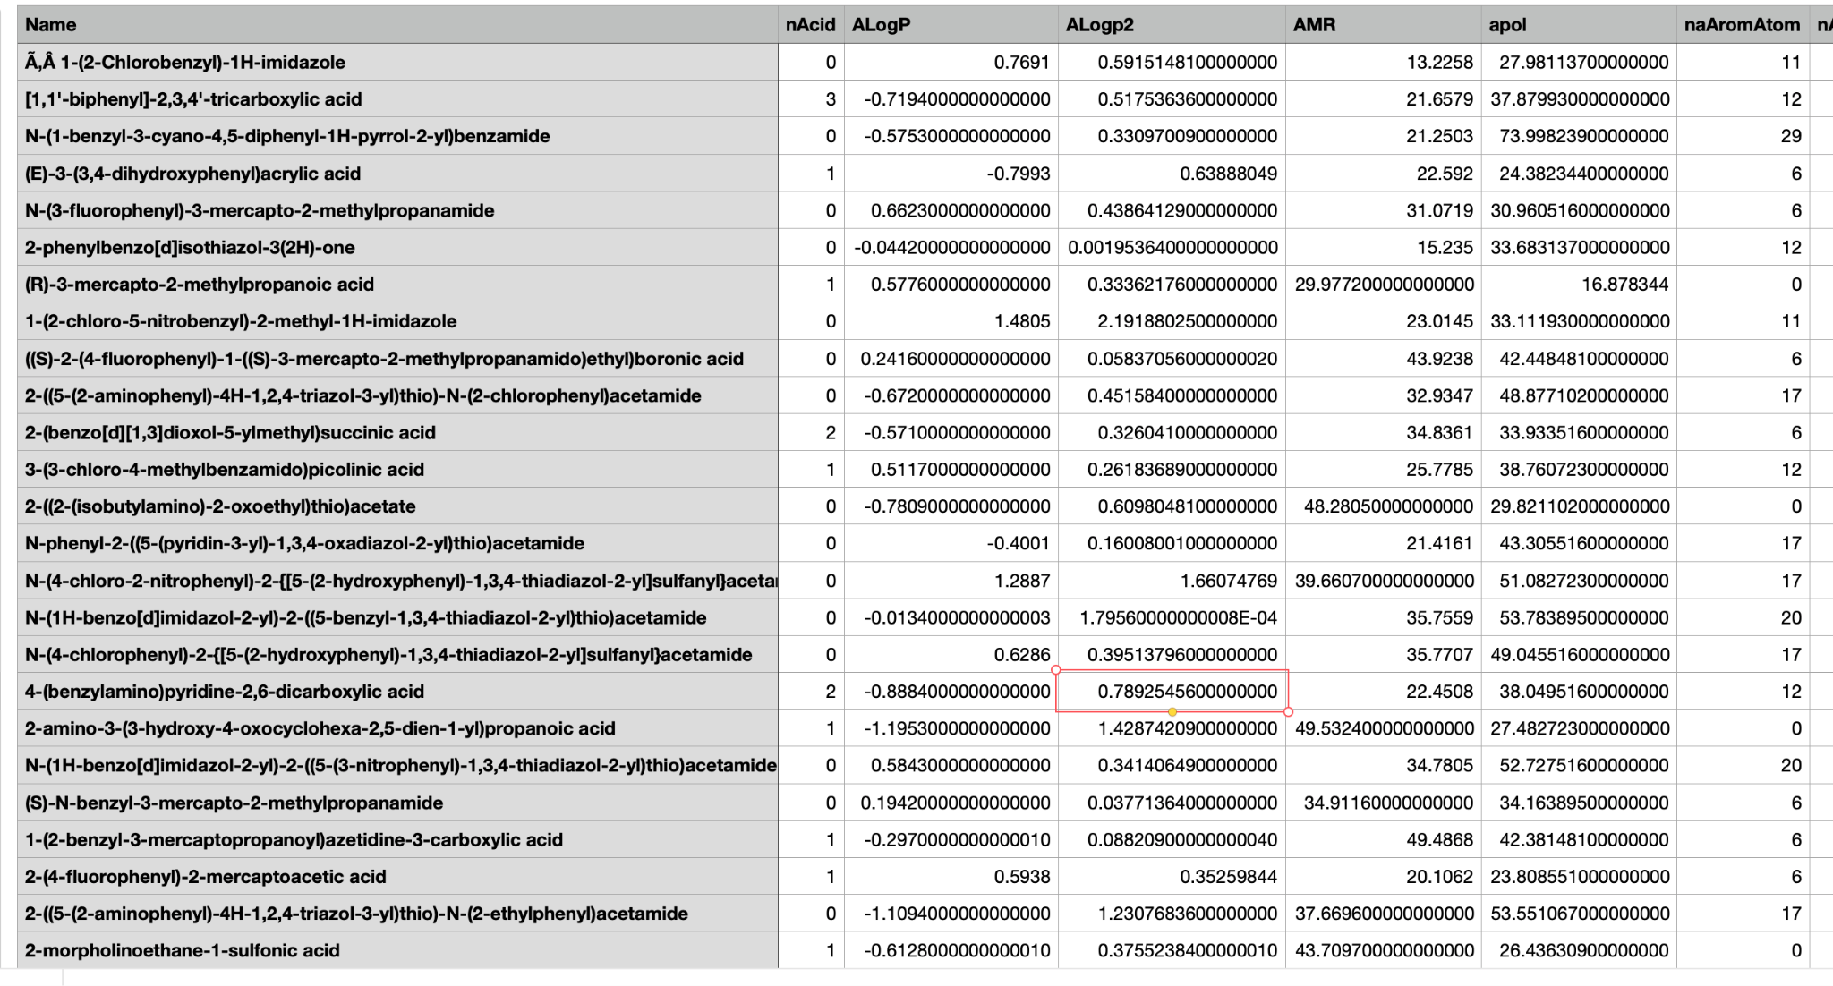
FEATURE EXTRACTION
USING PADEL EXTRACT FEATURES
2D AND 3D FEATURES (~1000 no.)
FILTER NULL VALUES AND INSIGNIFICANT
FEATURES(~700 no.)
‹#›

Slide 6
PIPELINE
PRE-PROCESSING OF THE COMPOUNDS
FEATURE EXTRACTION
FINAL CURATION OF TRAINING DATASET
LIGPREP
PADEL DESCRIPTORS
‹#›

Slide 7
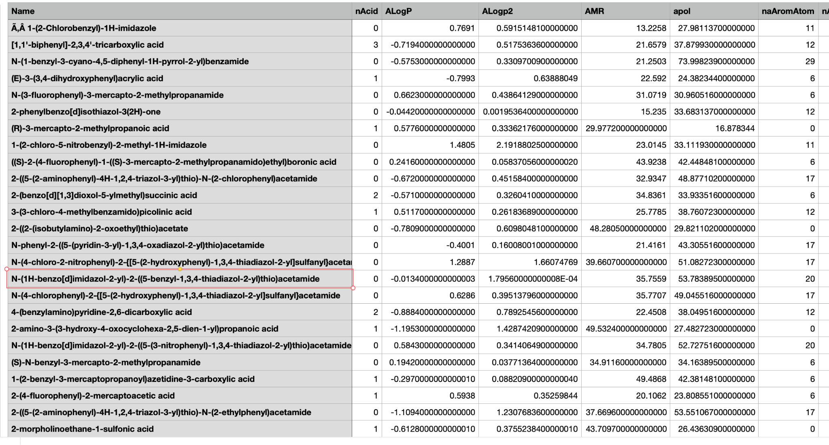
OVERVIEW OF THE DATASET
NAME OF THE COMPOUND | FEATURE 1 | FEATURE 2 | ..FEATURE N | INHIBITOR
 |  |  |  | 1
 |  |  |  | 0
882 * 798
‹#›

Slide 8
BINARY CLASSIFICATION MODEL PERFORMANCE
80.6%
RANDOM FOREST
80.1%
XGBOOST
74.5%
CATBOOST
71.8%
DECISION TREE
69%
K NEAREST NEIGHBOUR
67.1%
LINEAR REGRESSION
64.6%
NAIVE BAYES
53.2%
‹#›
SUPPORT VECTOR MACHINE

Slide 9
METHOD FOLLOWED
DATASET BALANCING
FEATURE ENGINEERING
MODEL BUILDING
PREDICTION ON TEST DATASET

Slide 10
DATASET STUDY
The number of rows and columns are almost the same
This increases the dimensionality
Higher the complexity, lesser the complexity
Solution:
Feature engineering
Dimensionality reduction
Number of rows | Number of features
882 | 798

Slide 11
DATA BALANCING
SMOTE - Synthetic Minority Oversampling Technique
For increasing the dataset
And balance the variables of the predicting class
 | Inhibitors | Non-inhibitors
Before Data balancing | 474 | 408
After Data balancing | 474 | 474

Slide 12
STATISTICAL DIMENSION REDUCTION TECHNIQUES
Remove Constant, Quasi Constant and Duplicate Features
Remove Correlated Features

Slide 13
FEATURE REDUCTION - DIMENSIONALITY REDUCTION
Dimension reduction
LDA
PCA
Accuracy Obtained: 85%
Accuracy Obtained:87%

Slide 14
MODEL
Random Forest after PCA reduction of dimensionality
Random Forest after LDA reduction of dimensionality
Parameter used:
n_estimators: 100
Accuracy obtained:
PCA and Random Forest - 87%
LDA and Randomforest - 85%

